Slide 1

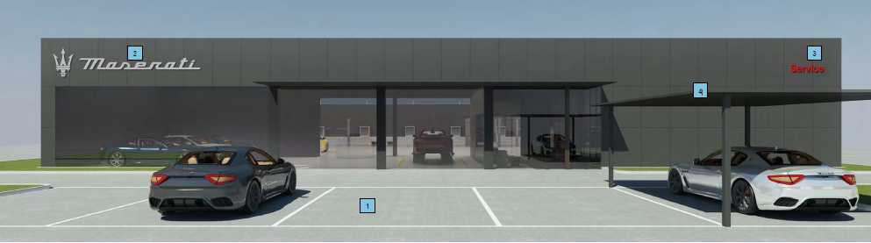
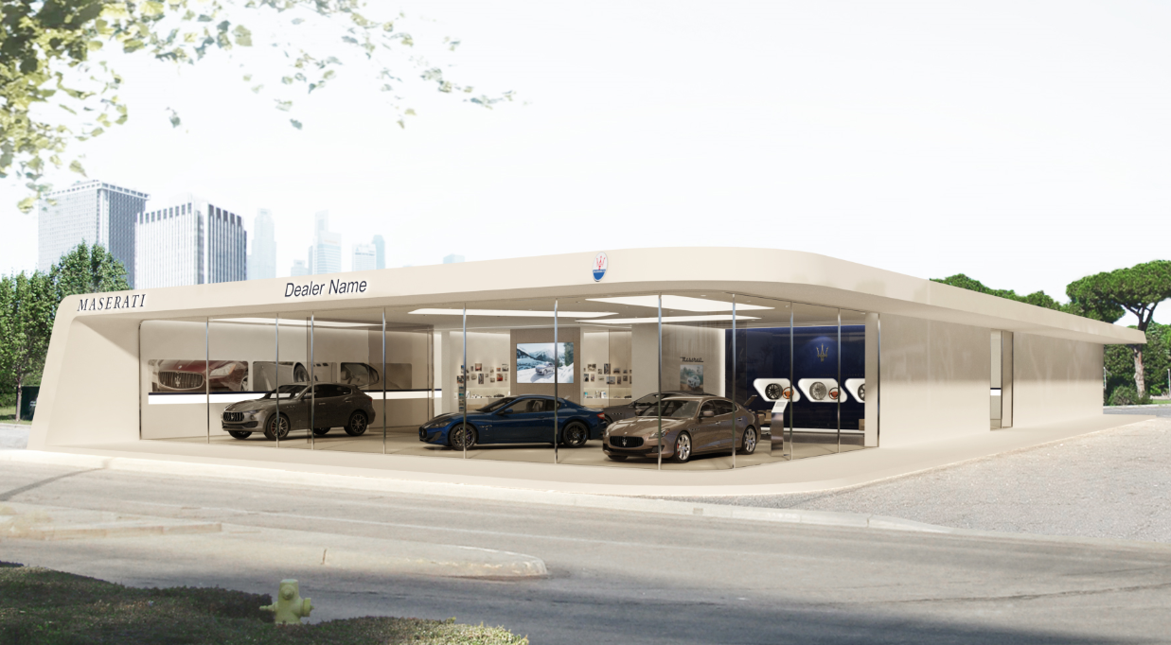
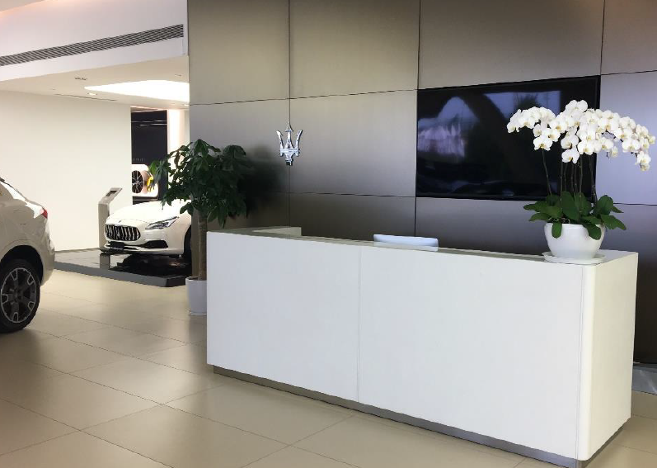
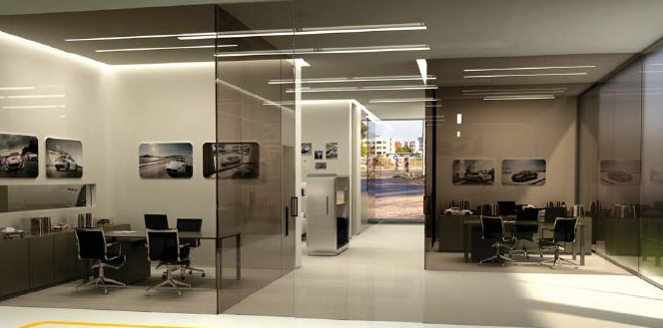
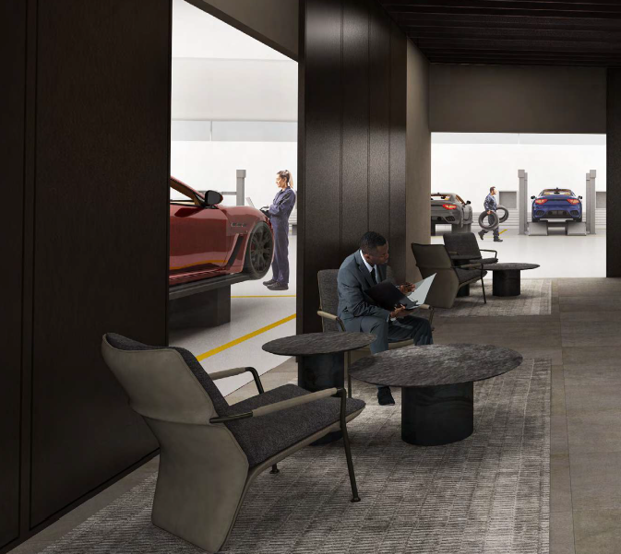
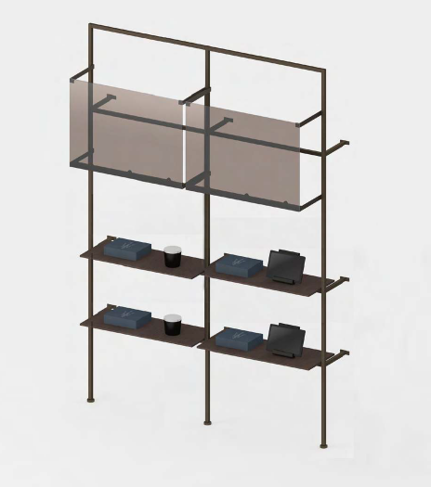

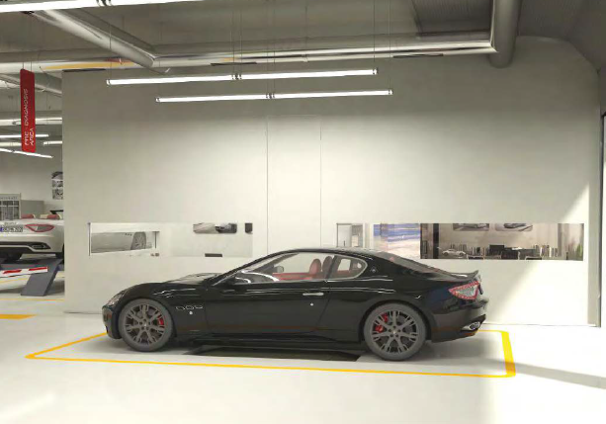
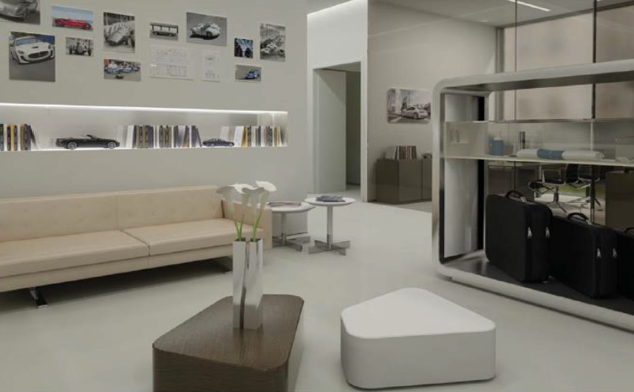
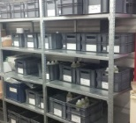
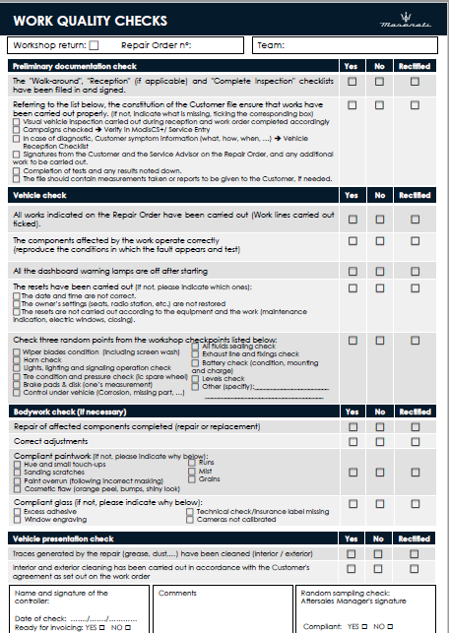
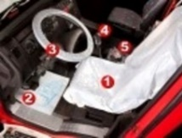
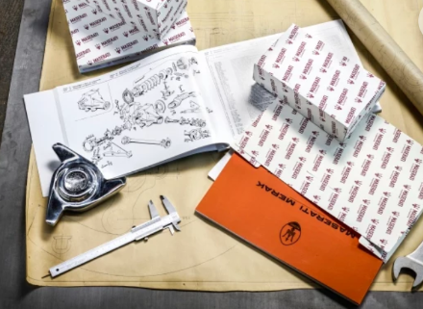
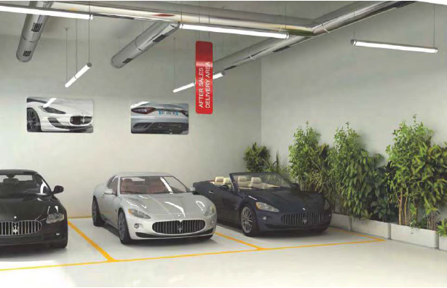
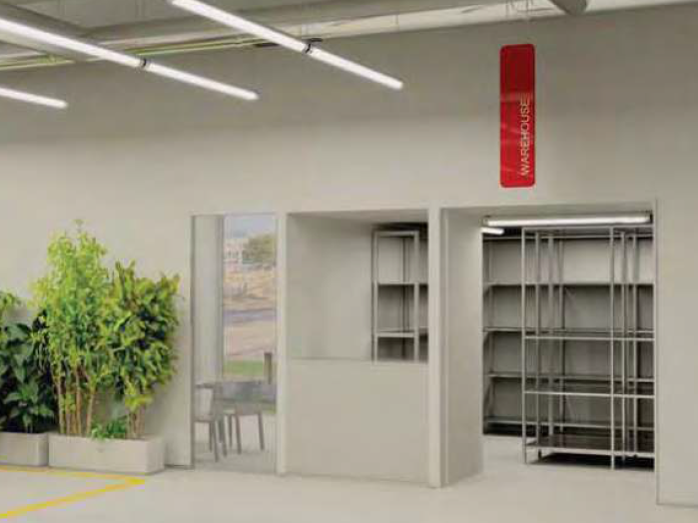
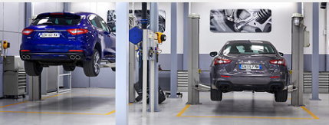
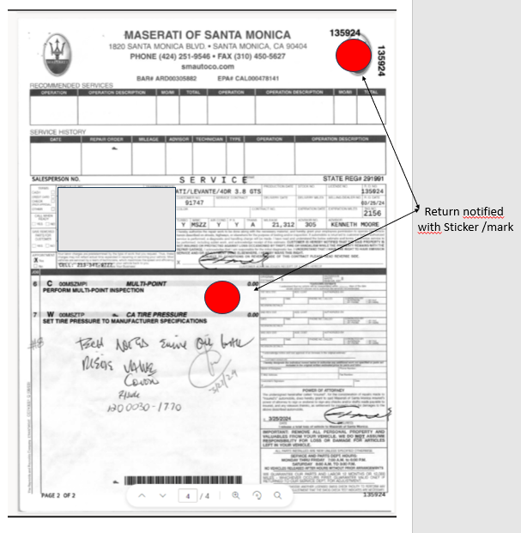
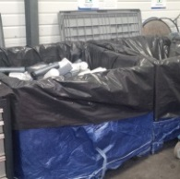
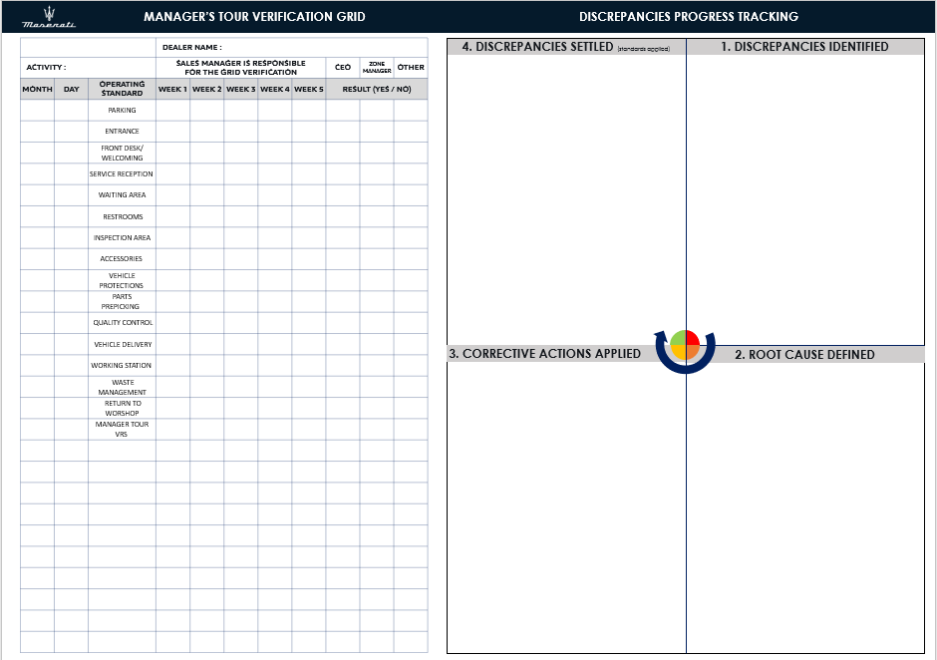
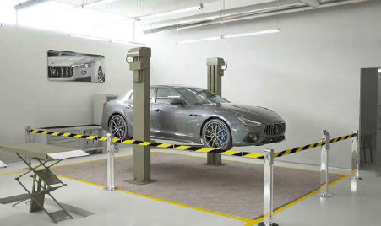
AFTERSALES MANAGER ’s TOUR
1
CUSTOMER PARKING
2
CUSTOMER ENTRANCE
3
Front desk - WELCOMING
4
Service reception
CHECK
CHECK
CHECK
CHECK
- Clean and visible window display.
- Outer visible signage of business hours/ Phone number and labour rate.
- Leaflets and other up to date offers.
- Staff immediately visible. Correct dress code, wearing badge.
- Receptions/counters easily identifiable to the customer.
- Clean, tidy, sober decoration. No countertop storage. Trash emptied
- Reception must be neat and in order, with no mess or papers visible on the desk.
- Leaflets and other up to date offers.
- Furniture is clean and undamaged.
- Staff immediately visible. Correct dress code, wearing badge.
- Parking for guests including service guests (possibly 24hrs stay).
- Brand labels/ tags/ signage visible & in good condition.
- Clean area with no bare ground within the 4m range.
- No cracks or depressions on the ground.
5,
5
WAITING AREA
6
Customer restrooms
7
VEHICLE INSPECTION AREA
8
PROMOTING ACCESSORIES
CHECK
CHECK
CHECK
CHECK
- Niches, ceiling, carpets, and furniture are clean, tidy and undamaged.
- Allowed products / lighting system in good condition.
- Hot & cold beverages with good quality should be available and visible for the customer.
- provide free WIFI and charging ports for cellphones/ PC…
- Lighting system is in good condition, undamaged, no noise, no dust.
- Remain clean and odor-free, facilities are undamaged and under normal use.
- Regularly cleaned, with a cleaning timetable kept.
- No visible storage of cleaning products or consumables.
- The service advisor should walk around the vehicle with the customer upon arrival and identify and notify to the customer the level of oil, any scratches or any visible defect.
- Clean and tidy inspection area.
- Customer access must be clean, there shouldn’t be any waste in the area and should grease and dirt free.
- Car space should be available.
- Commercial Add & brand brochures respect the commercial operation
- It should be up to date and aligned with the commercial plan.
- Branded accessories should be clean and displayed with a price tag.
9
VEHICLE PROTECTION PREP.
10
PARTS PRE-PICKING
11
QUALITY CONTROL
12
VEHICLE DELIVERY
CHECK
CHECK
CHECK
CHECK
- The vehicles upon inspection are protected in front of the customer
- Vehicle protection should include driver's seat, driver's footwell, steering wheel, gear lever knob and handbrake lever.
- The Parts are placed in boxes according to pre- picking list.
- The boxes are stored on shelves, day and week of the repair must be displayed.
- To Ensure that the products respect the expiration date.
- Upon compilation of the repair the assigned checklist for the vehicle must be present and displayed with the order repair, to certify that the vehicle was properly checked.
- Attention point! Make sure that the customer initial setting of the car (position of the seat, radio station etc…) are restored before delivery.
- The quality control checklist must be signed by the technician.
- The service advisor walks around the vehicle with the customer upon return, referring to the checklist completed upon vehicle inspection.
- The vehicles are returned in the presence of the service advisor.
- Vehicles are washed upon the initial wish of the customer and it’s free of charge after repair.
13
WORKING STATION AREA
14
WASTE MANAGEMENT AREA
15
RETURN TO WORKSHOP
16
MANAGER’S TOUR VRS
CHECK
CHECK
CHECK
CHECK
CHECK
CHECK
- Waste collection and disposal organized and in place.
- Absence of waste outside the containers provided for this purpose.
- Vehicles returning to the workshop identified from the appointment schedule and given priority
- The returning customer repair order/ job card must also be identified and highlighted with a specific tag or label for attention to the technician.
- Each vehicle return is notified in a follow up table which will report the root causes of the vehicle.
- Any discrepancies observed are notified using post-its or photos and must be reported in tracking table.
- This table must be stored by managers and display the root causes and corrective actions.
- This then must reflect all the historical discrepancies reported.
- Areas must be clean and tidy by anticipating any risk or staff injuries (protection measure for electric vehicle must be in place)
- Workers wear the appropriate Personal Protective Equipment, and their working clothes are not tainted.
- electric vehicles should be secured properly & in line with safety regulation
- Vehicles identified and protected.
- Extraction of exhaust gas in place for the vehicles concerned.
- Accessible and functional load terminal(s)
MAY 2024

